Slide 1
Environmental Studies
BCHS0201

Slide 2
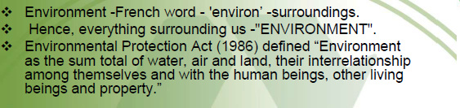
Definition

Slide 3
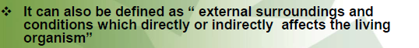

Slide 4
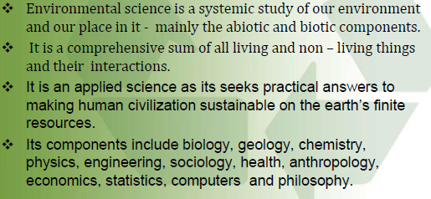

Slide 5
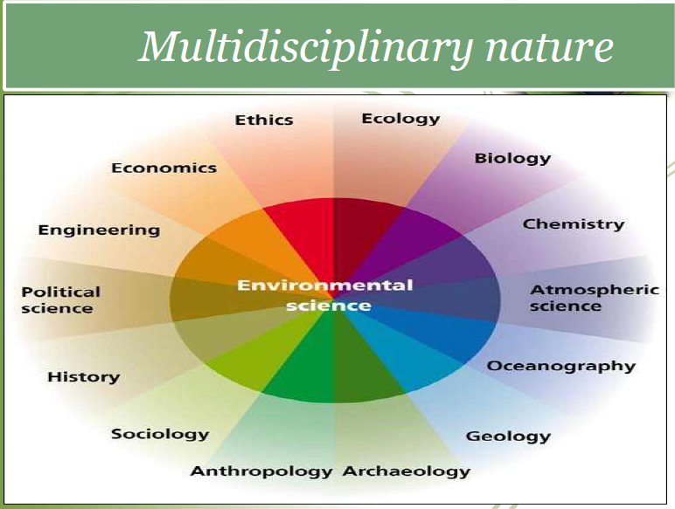

Slide 6
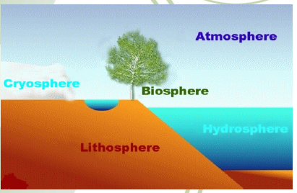
Environment

Slide 7
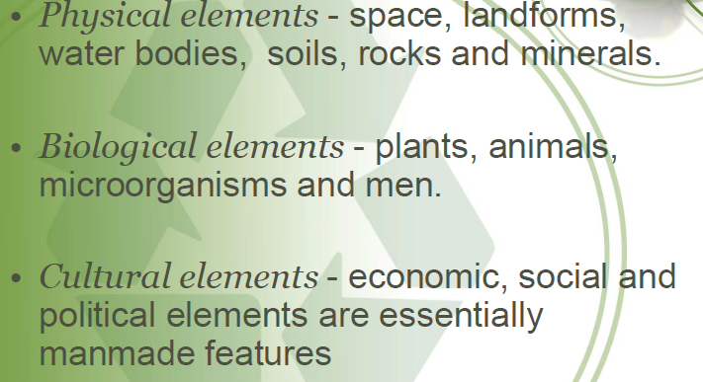
Elements of environment

Slide 8
Objective of this Course
• Develop CONCERN for our own environment.
• The concern leads us to ACT at your own level to protect the environment we all live in.

Slide 9
The three reasons for studying the state of the environment
• There is the need for information - the need to use resources more equitably.
• There is a need to change the way - based on observation and self learning.
• pro-environmental action - including activities we can do in our daily life to protect it.

Slide 10
WHY WE HAVE TO STUDY A COURSE ‘ENVIRONMENTAL STUDIES’ ???

Slide 11
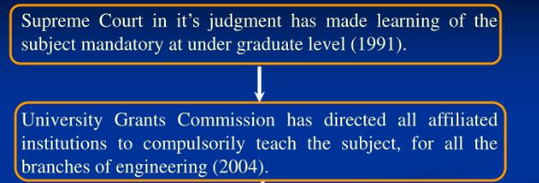
1.Legal Obligations

Slide 12
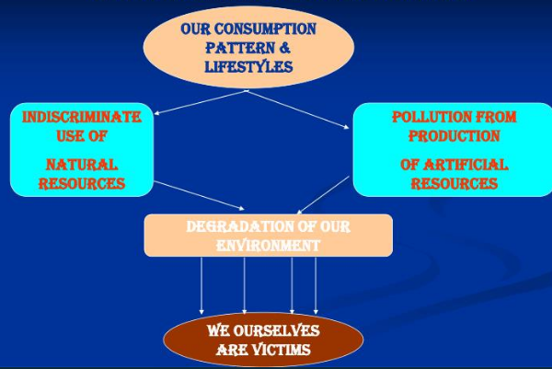
2.We are Victims of our own acts

Slide 13
3. You are going to be Modern day Professionals
Being Modern day Professionals, You will be required to encounter Environment related problems at all levels- Most importantly as Technical Managers directly facing the Society at large.

Slide 14
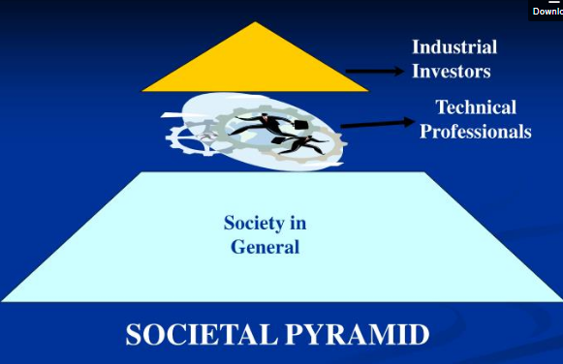
What do You Mean by this ? In what way we are responsible ?

Slide 15
So we are a class of our own.

Slide 16
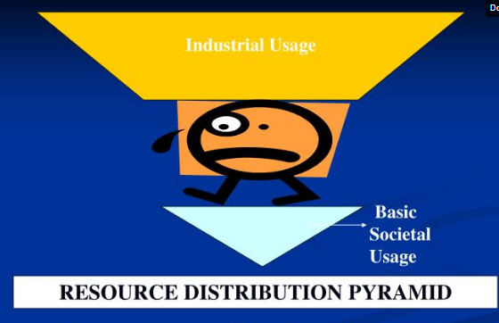

Slide 17
WHY SHOULD WE TEACH !
“If you plan for one year, plant paddy. If you plan for ten years, plant trees. But if you plan for hundred years, educate people.”

Slide 18
No Water? Drink Thanda!Case Study of Plachimada

Slide 19
HENCE THERE IS AN URGENT NEED TO UNDERSTAND THE PROBLEMS WE ARE FACING AND FORESEE THE CALAMITIES THAT MAY FALL ON US IF WE DO NOT TAKE CARE OF THE LOGICAL WARNINGS.
WISE PEOPLE SAY BETTER TO BE LATE THAN NEVER

Slide 20
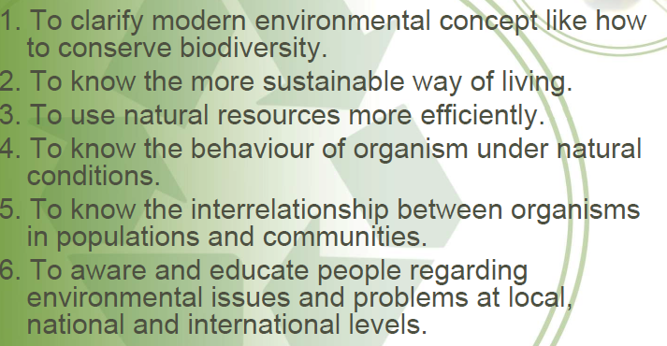
Importance of EVS

Slide 21
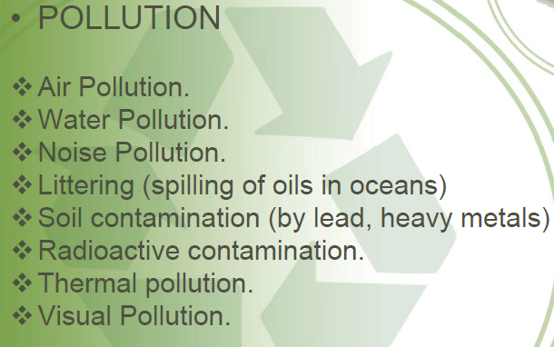
Current Environmental Problems

Slide 22
Global warming

Slide 23
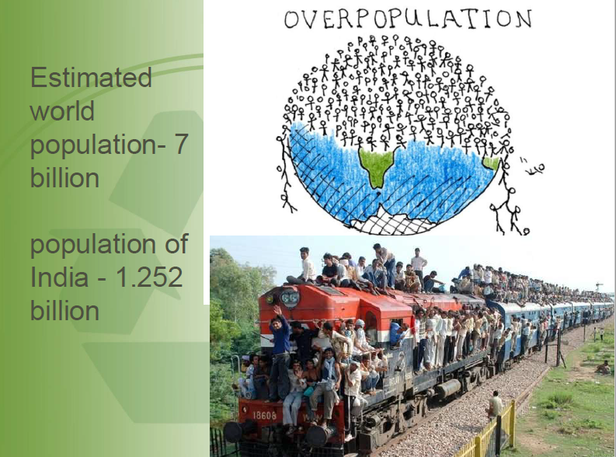

Slide 24
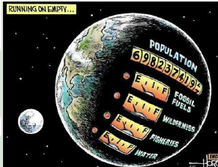
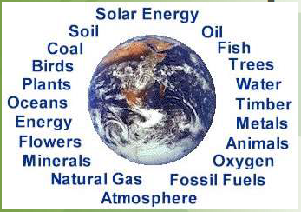
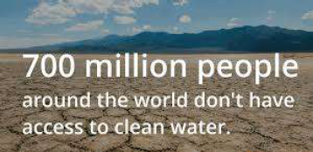
Natural Resource Depletion

Slide 25
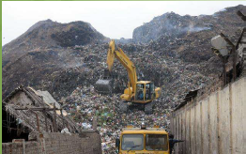
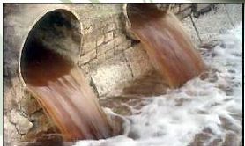
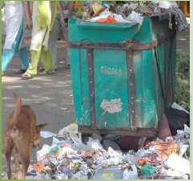
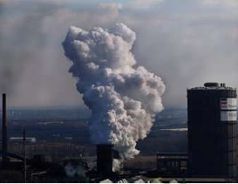
Improper Waste Disposal
Sewage Waste
Dumping of domestic waste
Plastic abuse
Industrial Chimney

Slide 26
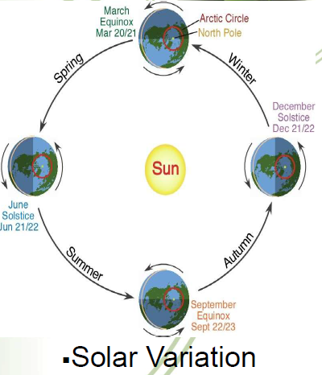
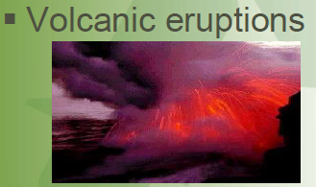
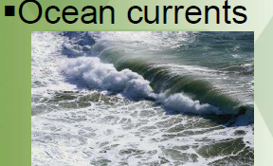
Climate change (1. Natural Causes)

Slide 27
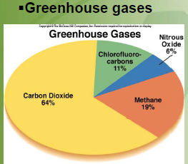
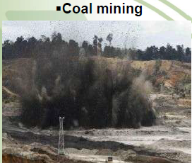
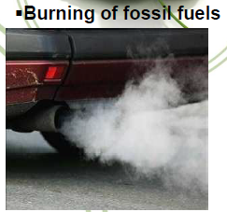
2. HUMAN CAUSES (Anthropogenic or Man-made causes)

Slide 28
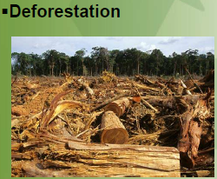
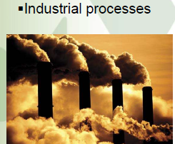

Slide 29
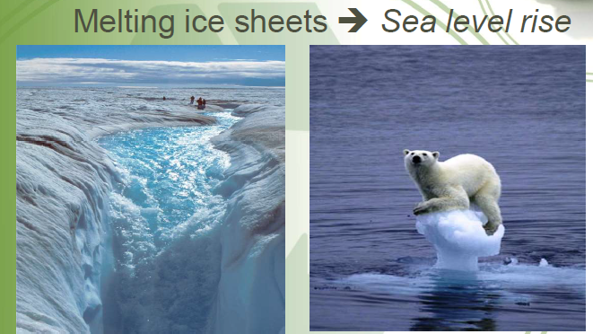
Effects of climate change

Slide 30
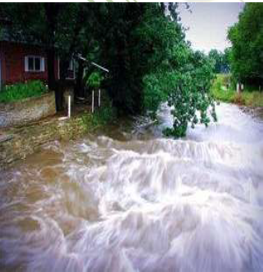
2.Heavy rain fall across the globe

Slide 31
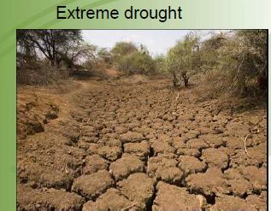
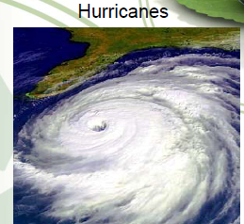
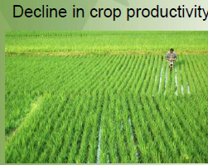
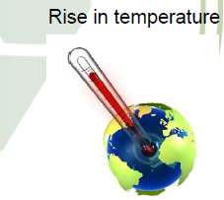

Slide 32
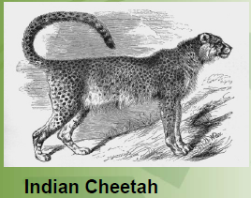
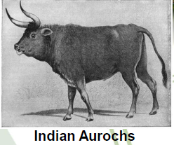
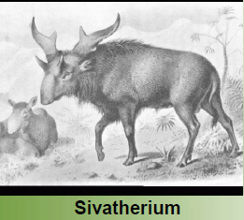
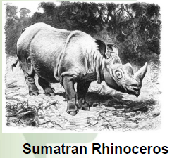

Extinct organism of India

Slide 33
National Environmental Problems
India,s Food Crisis
Food Security exists, when all people, at all times, have physical and economic access to sufficient, safe and nutritious food to meet their dietary needs and food preference for an active and healthy life.(World Food Summit, Rome, 1996)

Slide 34
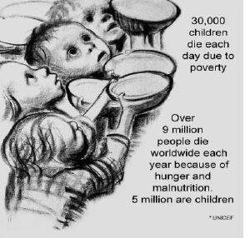

Slide 35
Cause of food shortage of India
•Improper methods of cultivation- not much use of
science and technology.
•Poverty and ignorance of Indian formers-Not much
financial support to farmers
•Wastage of food-in wrong process of cooking.
•Ignorance of preserving method-Improper storage facility.
•Defective food habit.

Slide 36
•Dishonesty of dealers.
•Excessive growth of population.
•Loss of fertility of soil by pollution
•Industrialization- Land loss
•Least interest on Agriculture –new generation
•Climate change –Improper rain-Acid rain
•Salinity in soil- soil pupation

Slide 37
Stark Realties
INDIA has witnessed high economic growth in last one decade
and high total production of food grains at the national level.

Slide 38
BUT India has
• 29% of the 872.9 million undernourished people (FAO)
• 49% of the world’s underweight children (WHO)
• 34% of the world’s stunted children (WHO)
• Over 46% undernourished children (WHO)
• India is ranked 67 way below neighboring countries like China,
Nepal & Pakistan, in 2011 Global Hunger Index by the IFPRI.
• As for child nutritional status & child mortality rate, India is doing
worse than some Sub-Saharan African Countries & South Asian
neighbours

Slide 39
Are we really food short ?
2nd largest arable land(184 million hectares) in the world.
Largest irrigated land(55 million hectares) in the world.
Largest producer of :
Wheat(15% of global production)
Pulses(21% of global production)
Milk(90 million tones).
Largest producer and exporter of spices.
2nd largest producer of rice(22% of global rice production) and the largest producer of world’s
best BASMATI RICE.
2nd largest producer of fruits and vegetables.
source: FICCI, Ministry of Agriculture(2008)

Slide 40
How to solve the food problem of India:
Introduction of improved method of cultivation based on science and technology.
• Improvement of financial and educational status of the Indian
cultivators.
Attracting educated people to the profession of cultivation.
Provision of water-pipes, electricity, insecticides, fertilizer and
research work for agriculture.

Slide 41
To refrain from holding feast and picnics in order to check the
possible wastage of food.
To know the proper method of dressing and cooking in order to
check the wastage of food.
To know the method of food preservation in order to save the
perishable foods from wastage.
Provision of cold storage in every village and refrigerator in every
household.
Changing food habit on everybody’s part.
Population control.

Slide 42
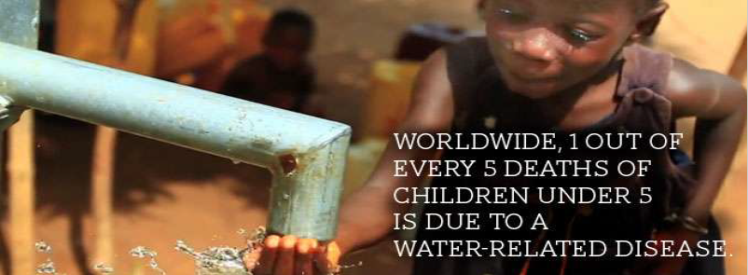
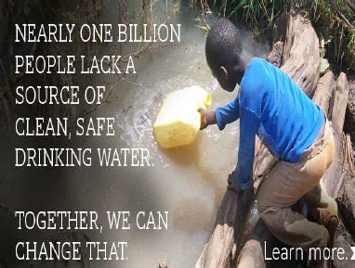
Water crisis

Slide 43
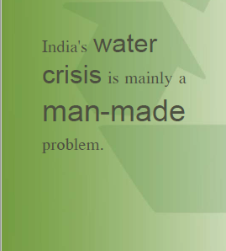

Slide 44
Causes for water scarcity
Population growth-over population
Food production-Agricultural irrigation
Climatic change and variability
Land use-industrialization
Water quality-pollution
Water demand-various purposes
Ground water exploitation
• Wastage of water

Slide 45
Effects
1 out of every 4 deaths under the age of 5 worldwide is due to a water-related disease.
80% of the Illness cause by unsafe water and Sanitation condition in world.
Every day in rural communities and poor urban centres throughout sub-Saharan Africa, hundreds of millions of people suffer from a lack of access to clean, safe water.

Slide 46
Women and girls especially bear the burden of walking miles at a time to gather water from streams and ponds - full of water-borne disease that is making them and their families sick.
Freshwater fish are going extinct at five times the rate
of marine fish species
In the last 100 years 50% of the world’s wetlands have been lost to development

Slide 47
Water Conservation Tips for Indoors
Let your parents know about leaks in your house
– Leaks are easily fixable and save you water and money
Tell your parents about high efficiency washers,faucets, and toilets
Run your dishwasher or washing machine only with full loads
Turn off the faucet when brushing or shaving
Take shorter showers

Slide 48


